Slide 1


Búsqueda de evidencia:
“La nueva habilidad clinica”
Liceo Contextual
11/05/2024
Santiago Castiello de Obeso, D.Phil.

Slide 2

¿Es importante saber buscar?

Slide 3
Pero antes…
¿es importante la MBE?

Slide 4
Evidencia
Experiencia
Valores y preferencias
Practicar la MBE significa integrar la competencia clínica individual con la mejor evidencia externa disponible a partir de la investigación sistemática. Siempre tomando en cuenta las preferencias de los pacientes.
Sackett David L, Rosenberg William M C, Gray J A Muir, Haynes R Brian, Richardson W Scott. Evidence based medicine: what it is and what it isn´t BMJ 1996; 312 : 71

Slide 5
Pacientes que ingresan a un hospital
P
I C
Práctica clínica con MBE
Vs.
Manejo estándar
O
Mortalidad, Tiempo hospitalario

Slide 6
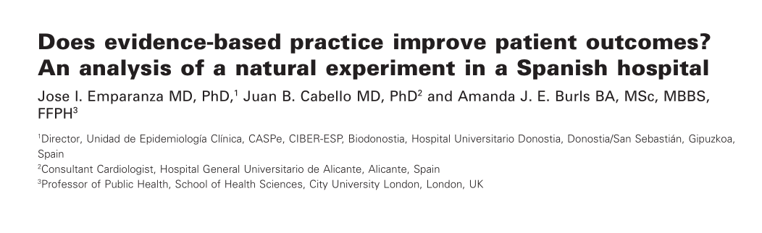
Emparanza, Jose I., Juan B. Cabello, and Amanda JE Burls. "Does evidence‐based practice improve patient outcomes? An analysis of a natural experiment in a Spanish hospital." Journal of evaluation in clinical practice 21.6 (2015): 1059-1065.

Slide 7
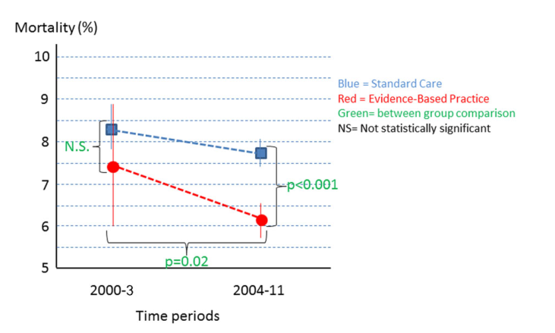

Slide 8
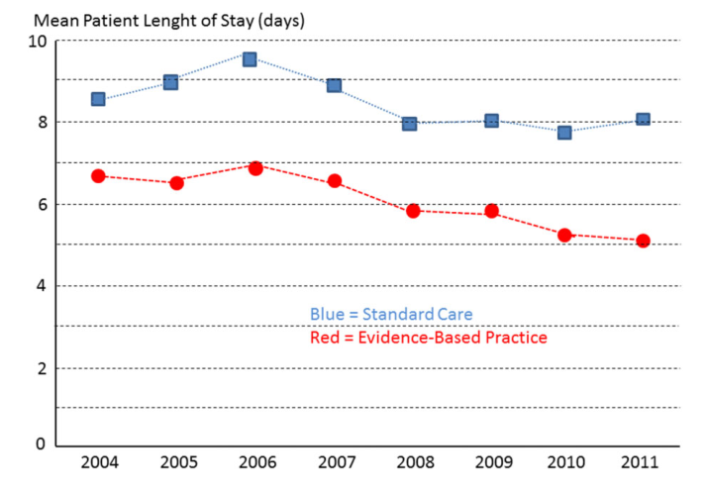

Slide 9
¿Por qué es importante la búsqueda de información en la práctica de la psicología de la salud, medicina basada en la evidencia, psicología clínica, o en ciencias de la salud?

Slide 10
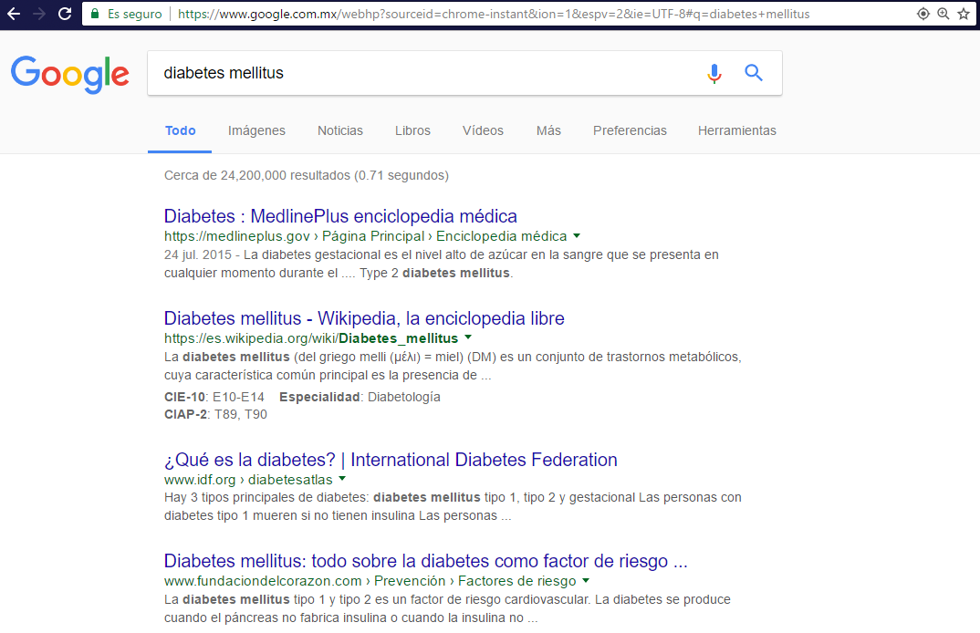
Más de 24,200,000 resultados

Slide 11
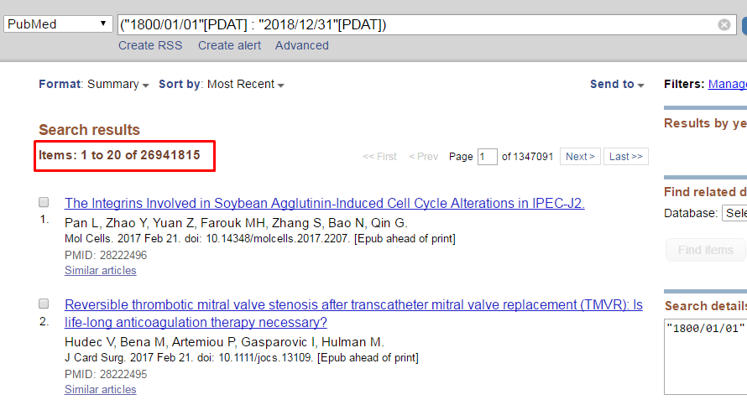

Slide 12
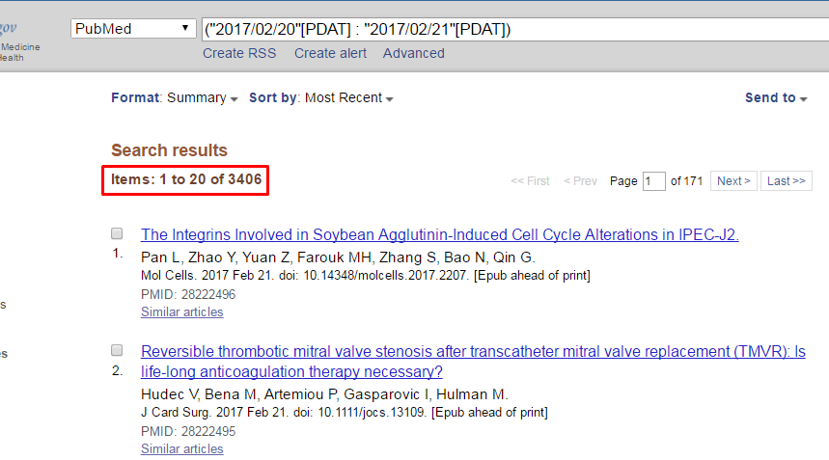

Slide 13
Infoxicación
intoxicación de información
Alvin Toffler (1970) acuña el término, y se refiere a cuando demasiada información nos limita para la toma de decisiones.
Es casi imposible acceder y revisar a fondo todo lo que publica sobre un determinado tema.

Slide 14
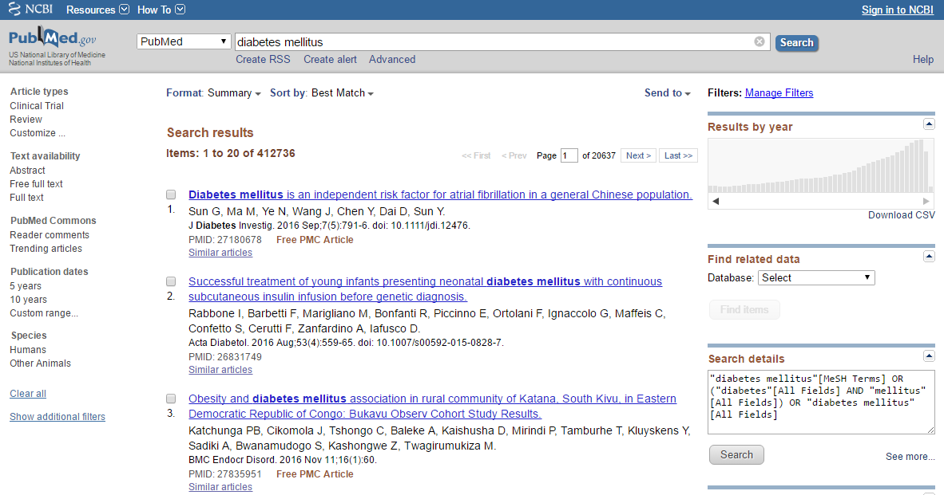
412,736 resultados

Slide 15
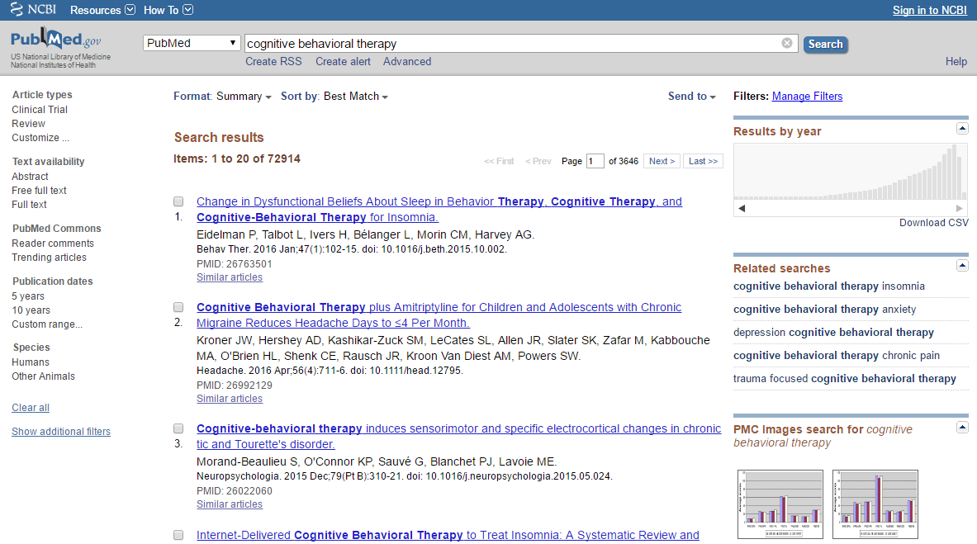
72,914 resultados

Slide 16
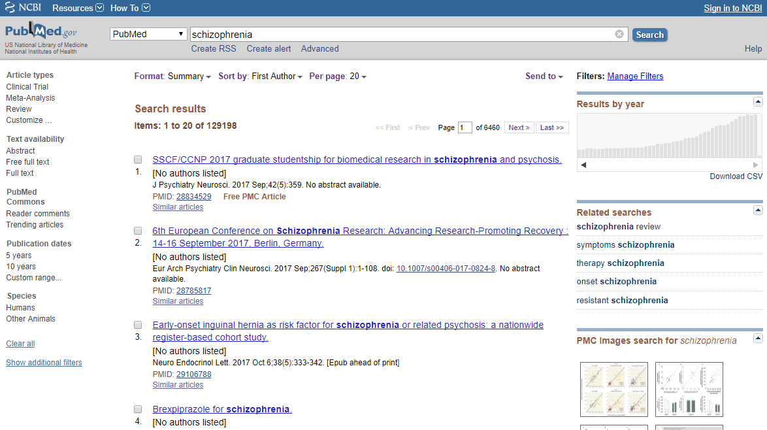
129,198 resultados

Slide 17
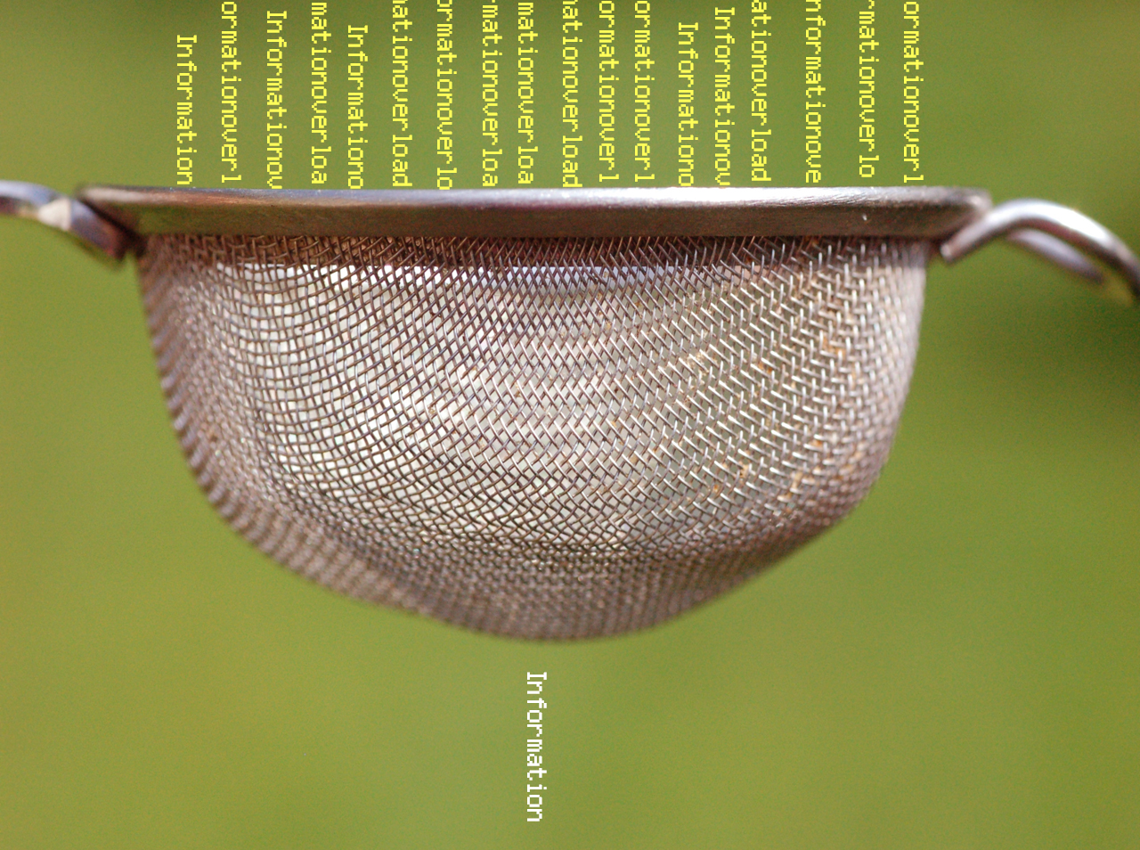
Necesitamos un filtro…

Slide 18
¿Cómo encontrar lo que necesito?
1. Definiendo nuestra pregunta
2. ¿Qué tipo de estudio responde la pregunta?
3. ¿Dónde puedo encontrar la respuesta?
4. ¿Cómo encuentro la respuesta?

Slide 19
¿Cómo encontrar lo que necesito?
1. Definiendo nuestra pregunta
2. ¿Qué tipo de estudio responde la pregunta?
3. ¿Dónde puedo encontrar la respuesta?
4. ¿Cómo encuentro la respuesta?

Slide 20
Pregunta PICO
P
Paciente
Intervención
Comparación
Outcome (desenlace)
I C
O

Slide 21



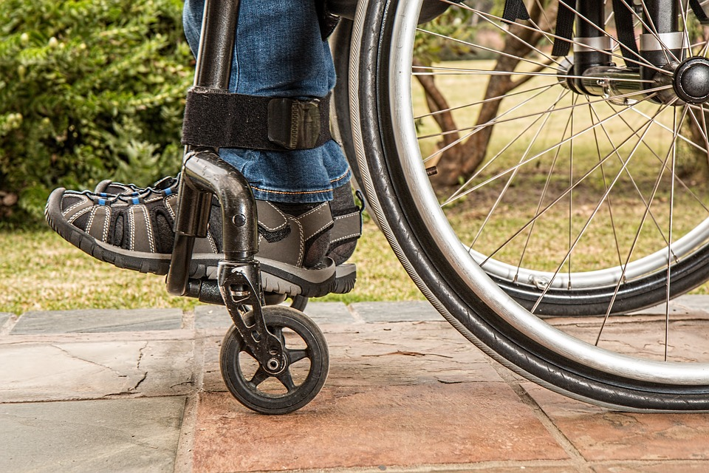
Tipos de Preguntas
Diagnóstico
Tratamiento
Riesgo
Pronostico

Slide 22
Pregunta: INTERVENCIÓN
P
P: diabetes (cualquier tipo)
I: tcc (terapia cognitivo conductual)
C:
O:
I C
O

Slide 23
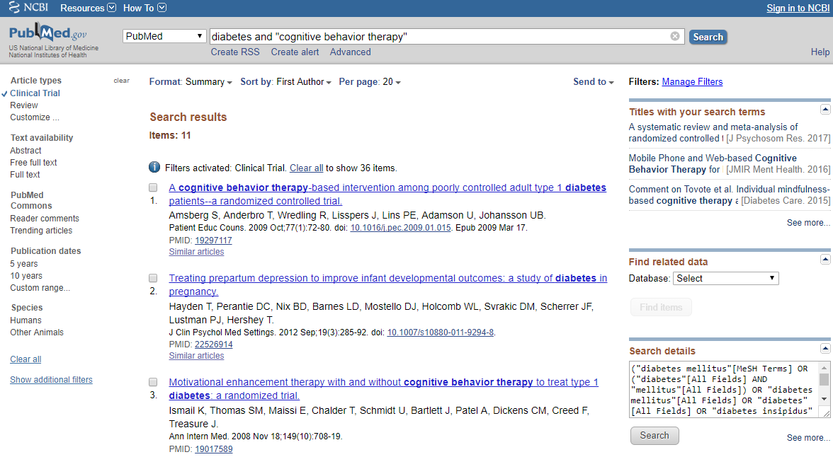

Slide 24
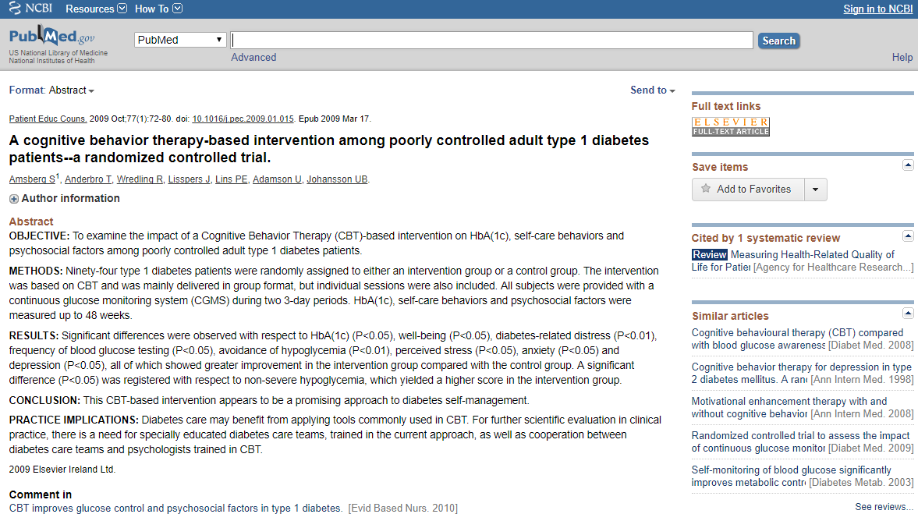
Reducción distrés de diabetes
Reducción episodios de hipoglicemia
Reducción ansiedad y depresión
Reducción en HbA(1c) (hemoglobina glicosilada)
Aumento de revisiones de glucosa
Amsberg, S., Anderbro, T., Wredling, R., Lisspers, J., Lins, P. E., Adamson, U., & Johansson, U. B. (2009). A cognitive behavior therapy-based intervention among poorly controlled adult type 1 diabetes patients—a randomized controlled trial. Patient education and counseling, 77(1), 72-80.

Slide 25
Pregunta: DIAGNÓSTICO
P
P: paciente con depresión
I: escala de depresión (Beck)
C: otra escala (Hamilton)
O:
I C
O

Slide 26
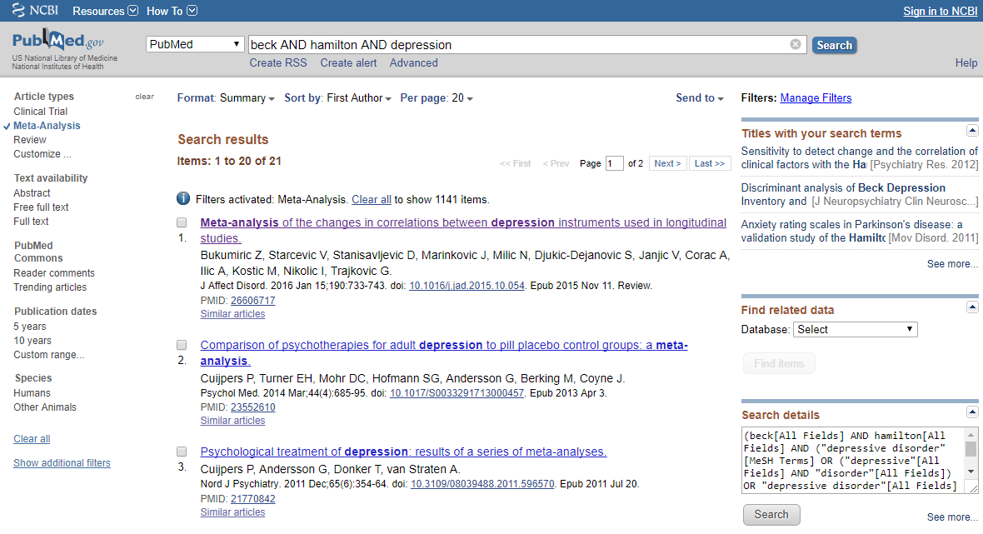

Slide 27
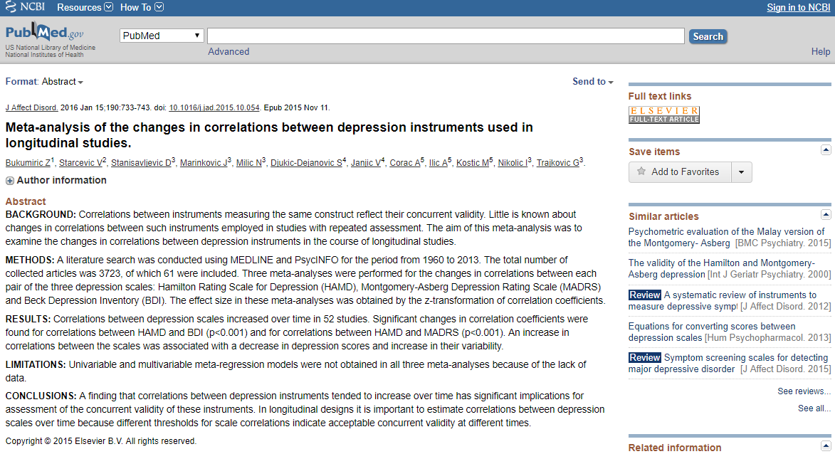
Alta correlación HAMD y BDI
Alta correlación HAMD y MADRS
Correlación mayor para bajos puntajes que altos
Bukumiric, Z., Starcevic, V., Stanisavljevic, D., Marinkovic, J., Milic, N., Djukic-Dejanovic, S., ... & Nikolic, I. (2016). Meta-analysis of the changes in correlations between depression instruments used in longitudinal studies. Journal of affective disorders, 190, 733-743.

Slide 28
Pregunta: PRONÓSTICO
P
P:
I: buena adherencia
C:
O: mortalidad
I C
O

Slide 29
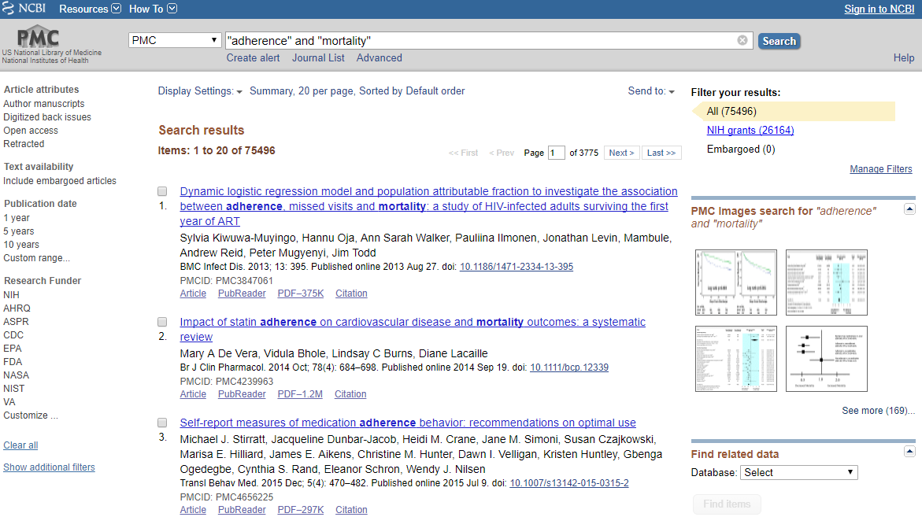

Slide 30
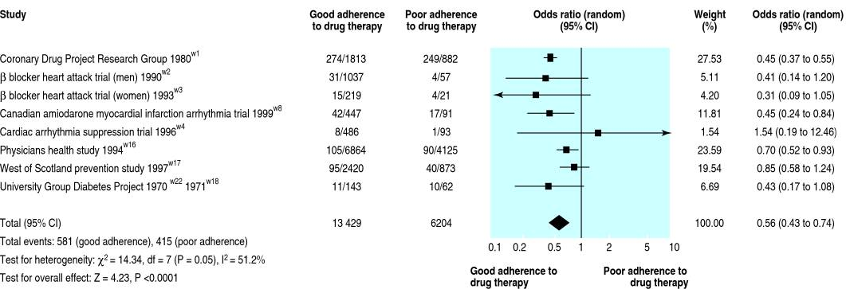
Simpson, S. H., Eurich, D. T., Majumdar, S. R., Padwal, R. S., Tsuyuki, R. T., Varney, J., & Johnson, J. A. (2006). A meta-analysis of the association between adherence to drug therapy and mortality. Bmj, 333(7557), 15.

Slide 31
estudios
grupos
unidad de análisis
Menor a 1 → favorece a la uena adherencia
Simpson, S. H., Eurich, D. T., Majumdar, S. R., Padwal, R. S., Tsuyuki, R. T., Varney, J., & Johnson, J. A. (2006). A meta-analysis of the association between adherence to drug therapy and mortality. Bmj, 333(7557), 15.

Slide 32
¿Cómo encontrar la mejor evidencia?
1. Definiendo nuestra pregunta
2. ¿Qué tipo de estudio responde la pregunta?
3. ¿Dónde puedo encontrar la respuesta?
4. ¿Cómo encuentro la respuesta?

Slide 33
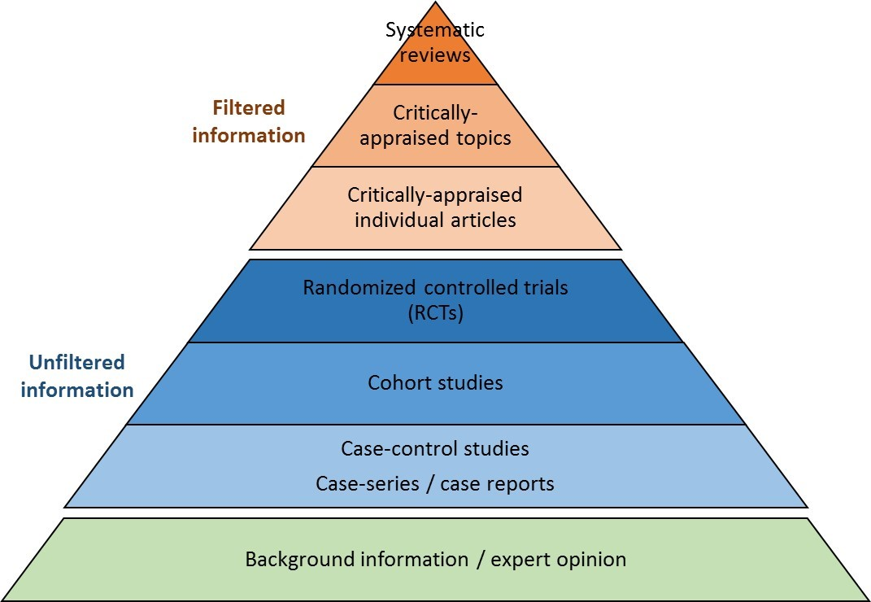
Pirámide de la evidencia
Calidad
de la evidencia
¿Qué tipo de estudio responde mejor a mi pregunta?

Slide 34
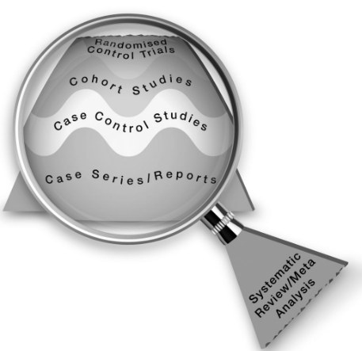
Pirámide de la evidencia
¿Qué tipo de estudio responde mejor a mi pregunta?
Murad MH, Asi N, Alsawas M, Alahdab F. New evidence pyramid. Evid Based Med. 2016 Aug;21(4):125-7.

Slide 35
Pirámide de la evidencia
¿Qué tipo de estudio responde mejor a mi pregunta?
Murad MH, Asi N, Alsawas M, Alahdab F. New evidence pyramid. Evid Based Med. 2016 Aug;21(4):125-7.

Slide 36
¿Cómo encontrar la mejor evidencia?
1. Definiendo nuestra pregunta
2. ¿Qué tipo de estudio responde la pregunta?
3. ¿Dónde puedo encontrar la respuesta?
4. ¿Cómo encuentro la respuesta?

Slide 37

Guías de práctica clínica
Sumarios y guías
Revisiones sistemáticas
Investigación evaluada
Estudios primarios
Investigación no evaluada

Slide 38
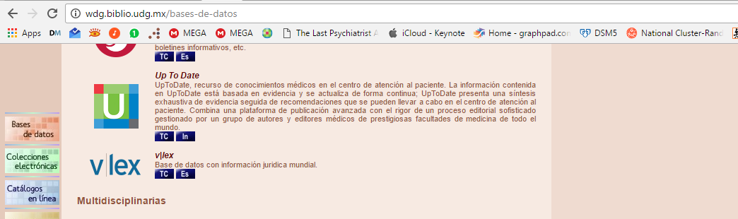
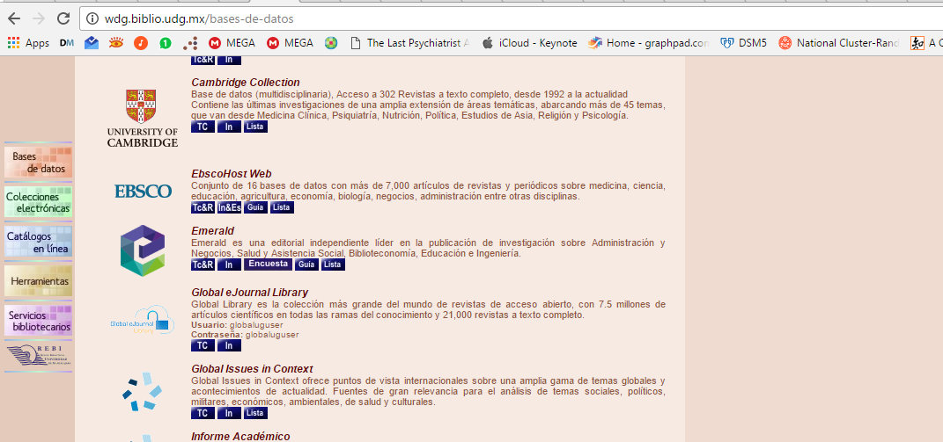

Slide 39


Entre otros…

Slide 40
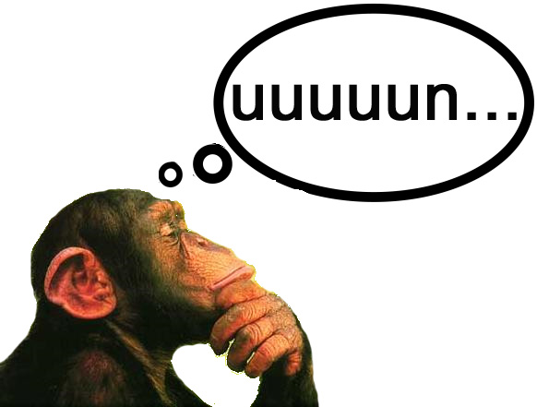
¿Cuál es mejor UpToDate o DynaMed?

Slide 41
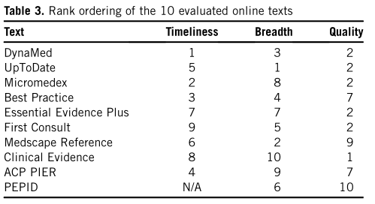
actualización
extención
calidad
Prorok, Jeanette C., et al. "The quality, breadth, and timeliness of content updating vary substantially for 10 online medical texts: an analytic survey." Journal of clinical epidemiology 65.12 (2012): 1289-1295.
Notes:
OBJECTIVE:
To evaluate the quality of evidence reporting, breadth of coverage, and timeliness of content updating of 10 selected online medical texts.
STUDY DESIGN AND SETTING:
Each text was assessed for quality based on an 11-item scale, which included items related to editorial policy and updating, appraisal, and transparent incorporation of newly published clinical research and evidence-based guidelines. Breadth of coverage was determined by the percentage of 60 randomly selected International Classification of Diseases 10 (ICD-10) codes covered by each of the texts. The same 60 ICD-10 codes were used to obtain a sample of topic chapters for the assessment of timeliness of updates.
RESULTS:
Quality scores ranged from a high of 9 of 11 points (Clinical Evidence) to a low of 0 of 11 points (PEPID), with a mean score of 6.7. Breadth of coverage ranged from 83% of randomly selected topics covered (UpToDate) to 25% (Clinical Evidence), with 6 of 10 texts covering 60% or more; average coverage across all texts was 57%. Variability was also observed with regard to average time since last content update, ranging from 3.5 (DynaMed) to 29 months (First Consult), with an average time since update of 12.4 months.
CONCLUSION:
No single resource was ideal and those seeking answers to clinical questions are well-advised not to rely solely on a single point-of-care product.

Slide 42

entonces…
¿UpToDate no es tan bueno?

Slide 43
Pacientes que ingresan a un hospital
P
I C
Hospital con UpToDate
Vs.
Hospital sin UpToDate
O
Tiempo hospitalario

Slide 44
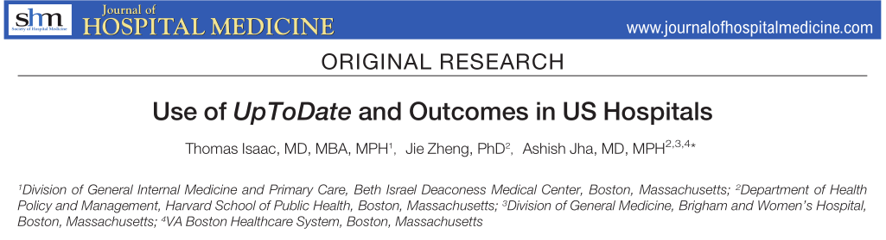
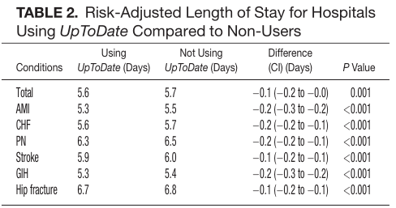
disminuye en 0.1 días la estancia hospitalaria

Slide 45
¿Cómo encontrar la mejor evidencia?
1. Definiendo nuestra pregunta
2. ¿Qué tipo de estudio responde la pregunta?
3. ¿Dónde puedo encontrar la respuesta?
4. ¿Cómo encuentro la respuesta?

Slide 46

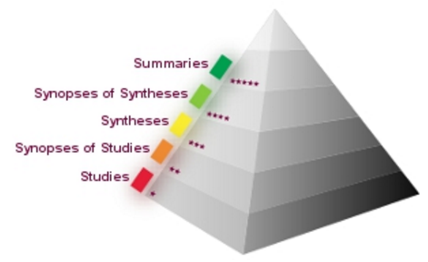





Slide 47

¿Cómo lo tratan? ¿A quién lo derivan?

Slide 48
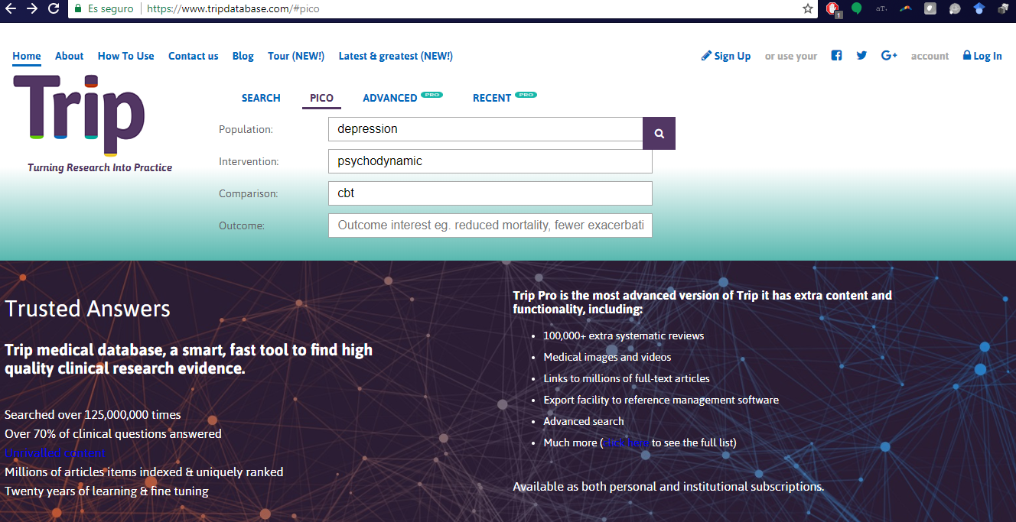

Slide 49
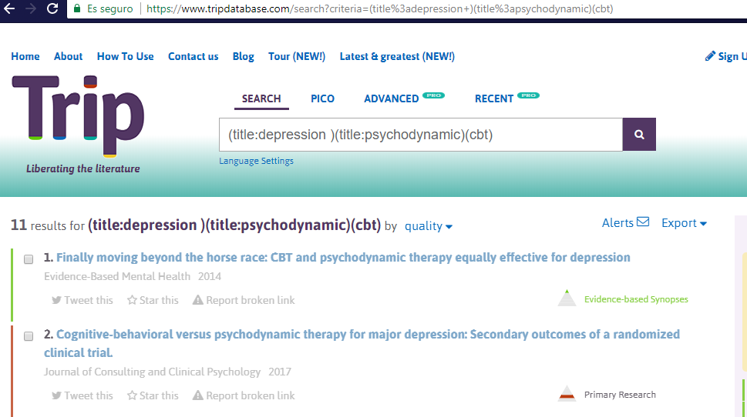

Slide 50
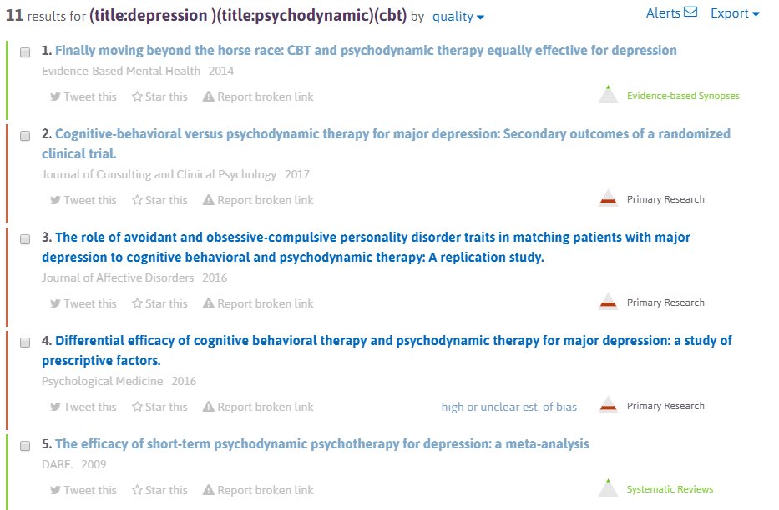

Slide 51
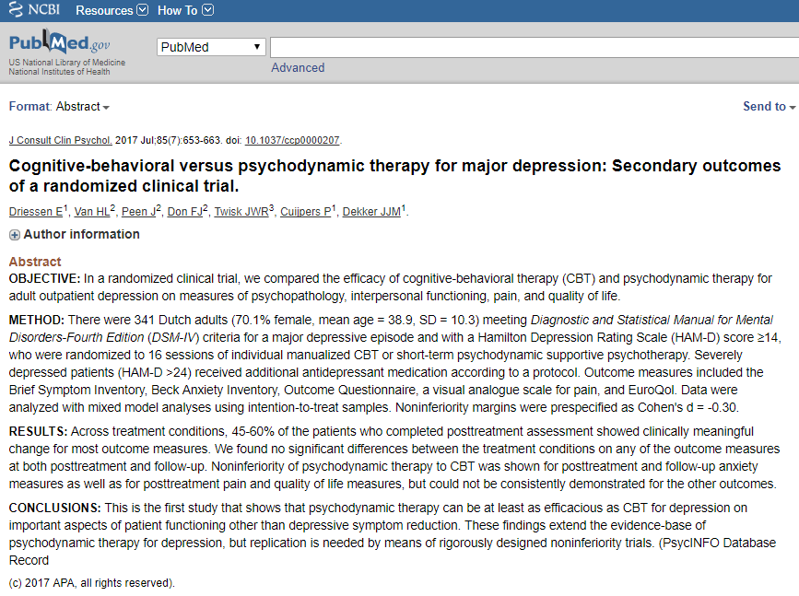
¡OJO!
Encontrar resultado no implica que sea buena evidencia
¡2do OJO!
Criticar intervenciones por plausibilidad teórica nos puede llevar a cometer errores.

Slide 52
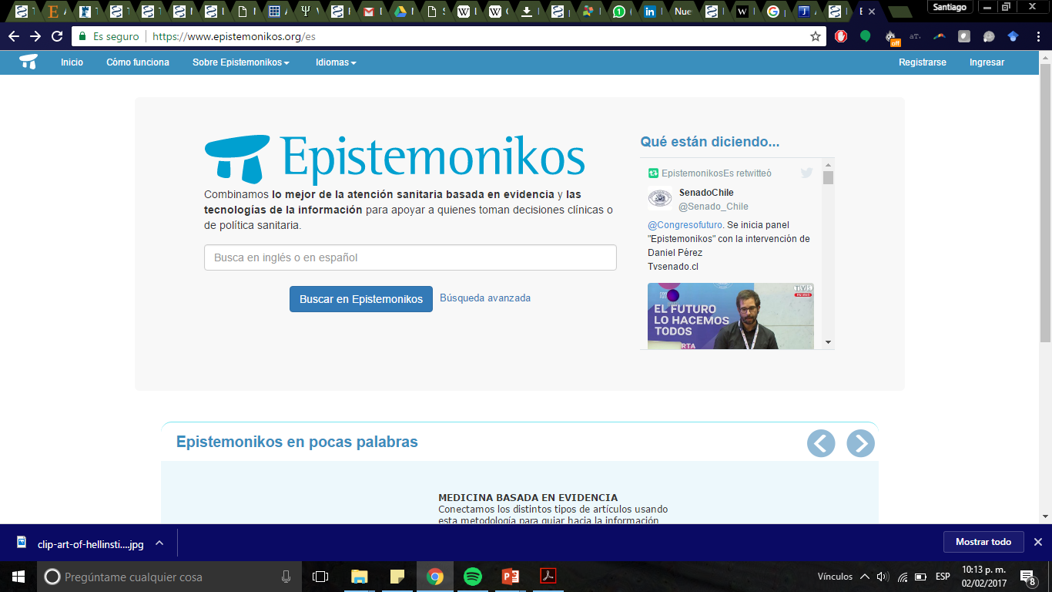

Slide 53


Psicólogo pide empleo
Sabe de evidencia…
Jefe de departamento cirujano…

Slide 54
Pacientes postquirúrgicos
P
I C
Preparaciones psicológicas
Vs.
Sin preparación
O
Tiempo hospitalario, dolor, estado de afecto

Slide 55
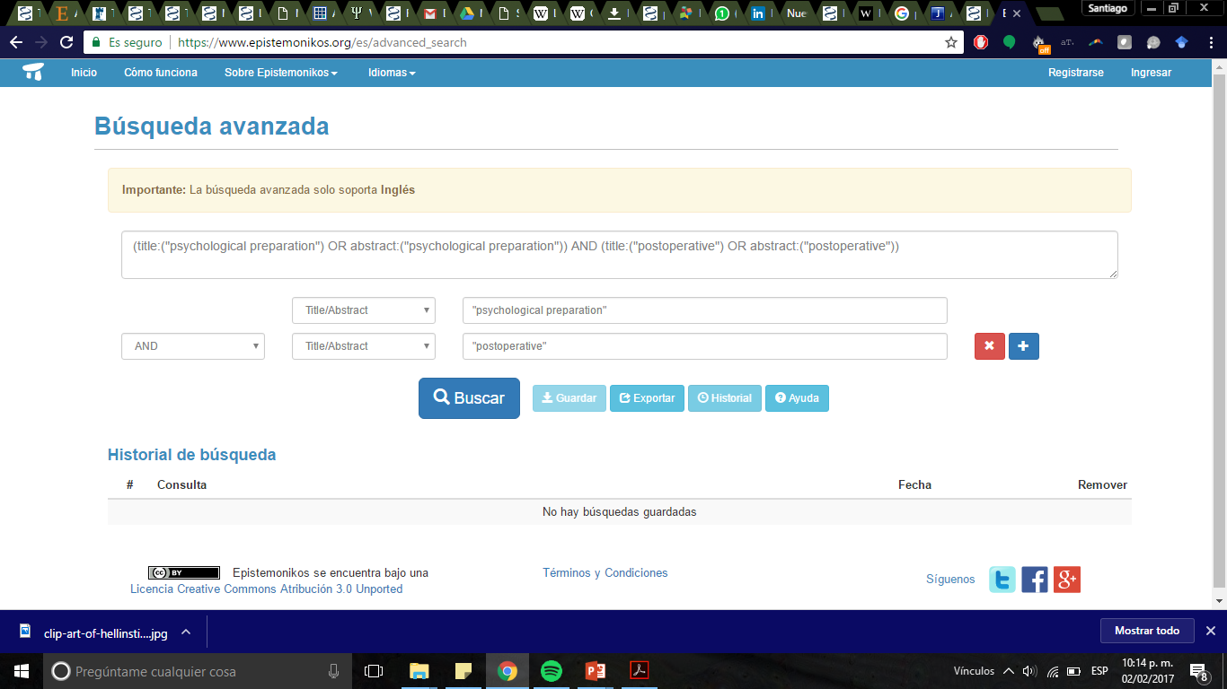

Slide 56
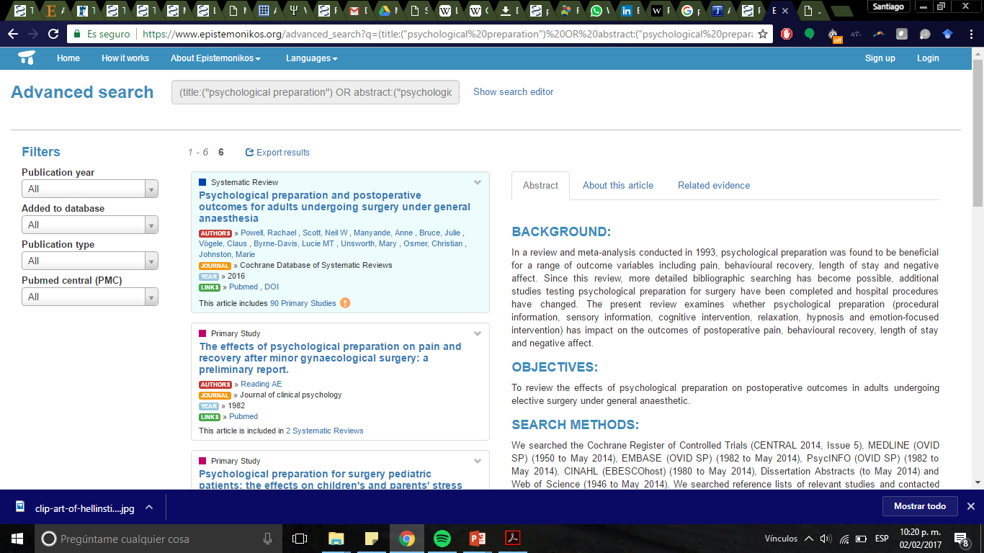

Slide 57
Reducción dolor
Reducción días de estancia hospitalaria
Reducción afectos negativos
Powell R, Scott NW, Manyande A, Bruce J, Vögele C, Byrne-Davis LMT, Unsworth M, Osmer C, Johnston M. Psychological preparation and postoperative outcomes for adults undergoing surgery under general anaesthesia. Cochrane Database of Systematic Reviews 2016, Issue 5. Art. No.: CD008646.

Slide 58
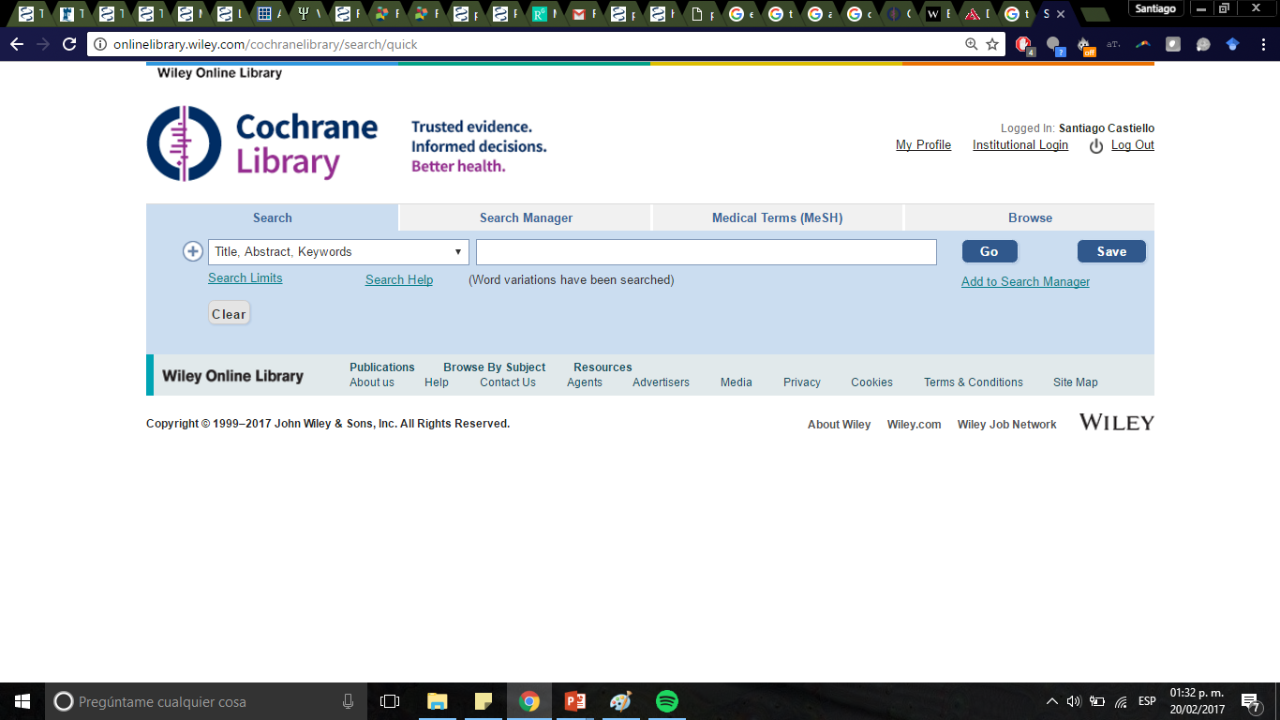

Búsquedas en recursos particulares

Slide 59
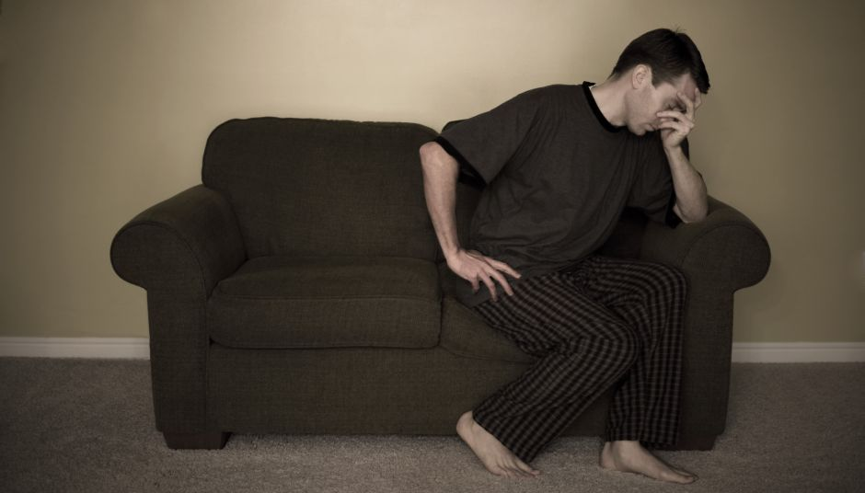

Por ejemplo…

Slide 60
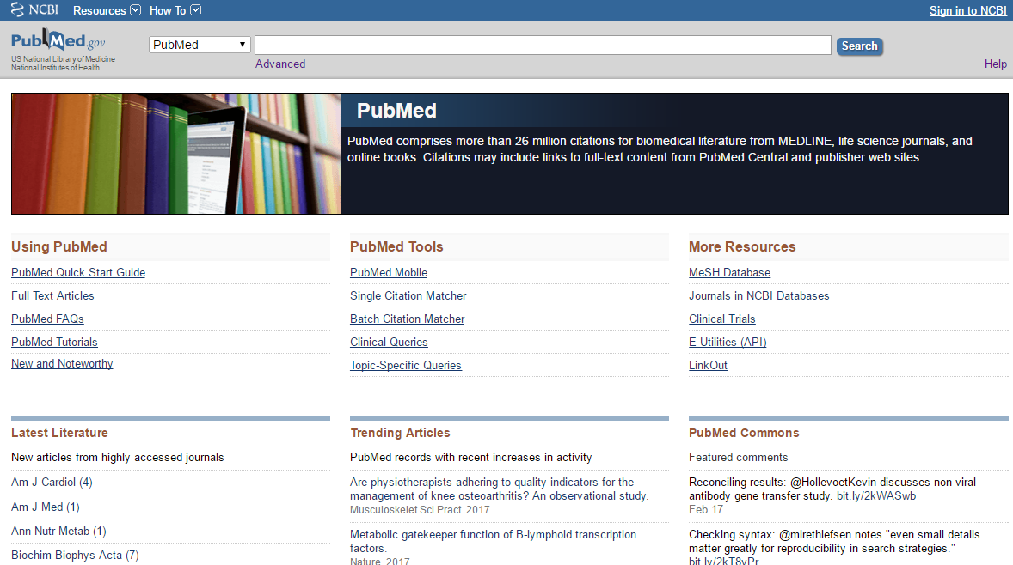

Slide 61
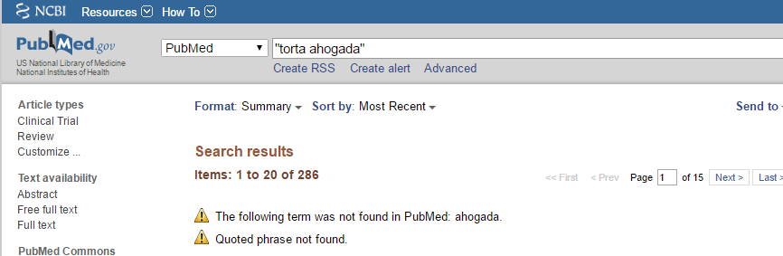

Slide 62
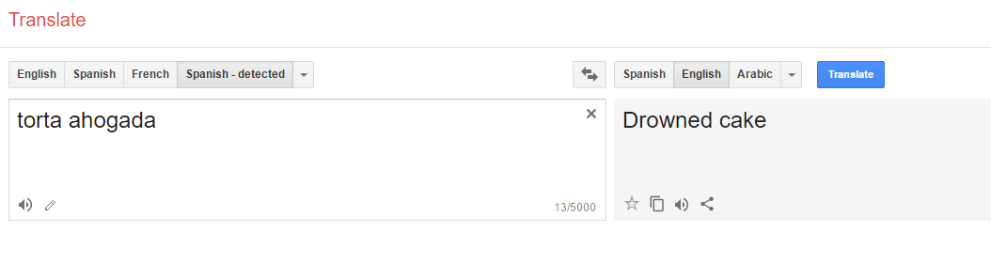

Slide 63
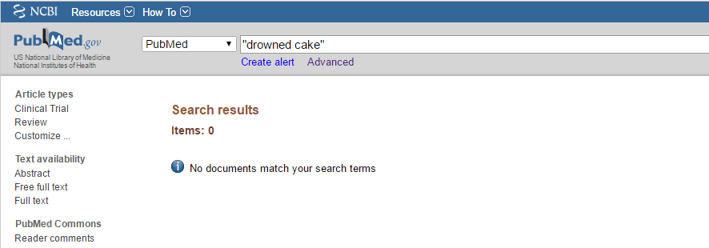

Slide 64
¿Cómo lo buscarían?

Slide 65
Pacientes con hemorroides
P
I C
Torta ahogada con picante
Vs.
Torta ahogada sin picante
O
sangrado, hinchazón, dolor, comezón, o ardor

Slide 66
Pacientes con hemorroides
P
I C
Torta ahogada con picante
Vs.
Torta ahogada sin picante
O

Slide 67
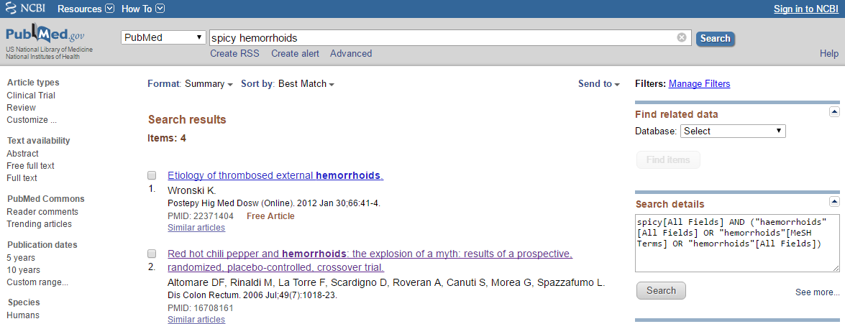

Slide 68
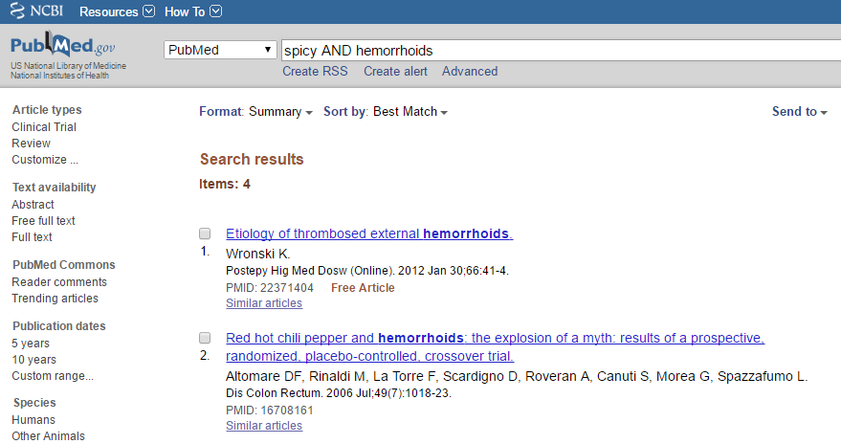
No evidencia de que el chile picante aumente:
sangrado
hinchazón
dolor,
comezón, ni
ardor
palabras clave y operadores booleanos

Slide 69
palabras clave y operadores booleanos

Slide 70
Herramientas de búsqueda

Slide 71
Herramientas de búsqueda
1. Operadores booleanos
2. Uso de “”
3. MeSH
4. Filtros
5. Descriptores

Slide 72
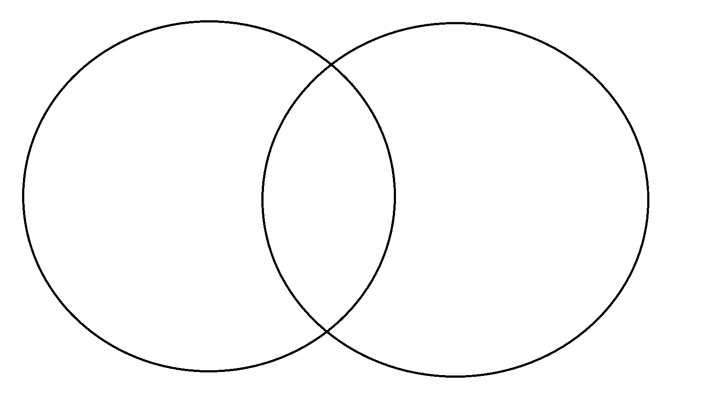
OPERADORES BOOLEANOS
Teoría de conjuntos
A
B

Slide 73
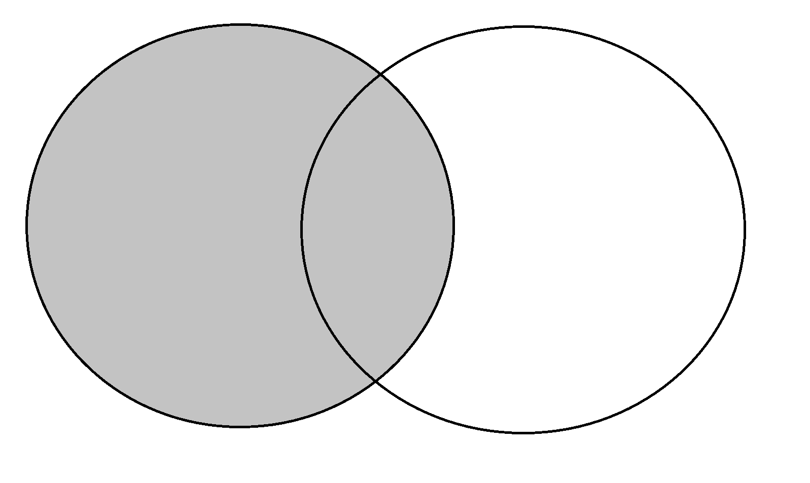
A
diabetes
N = 443051

Slide 74
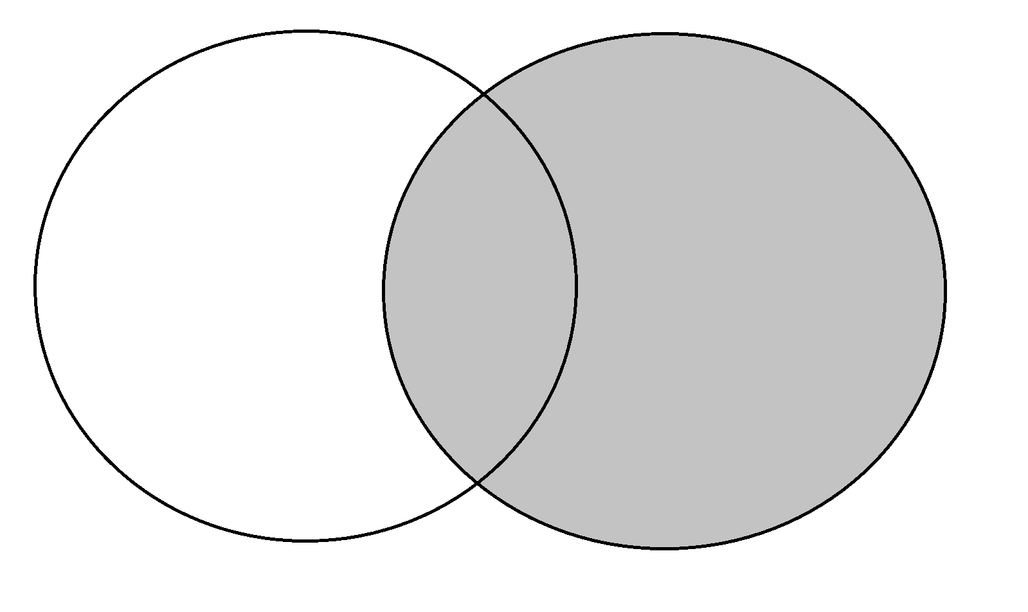
B
cognitive behavioral therapy
N = 6970

Slide 75
1er operador booleano
Intersección o AND

Slide 76
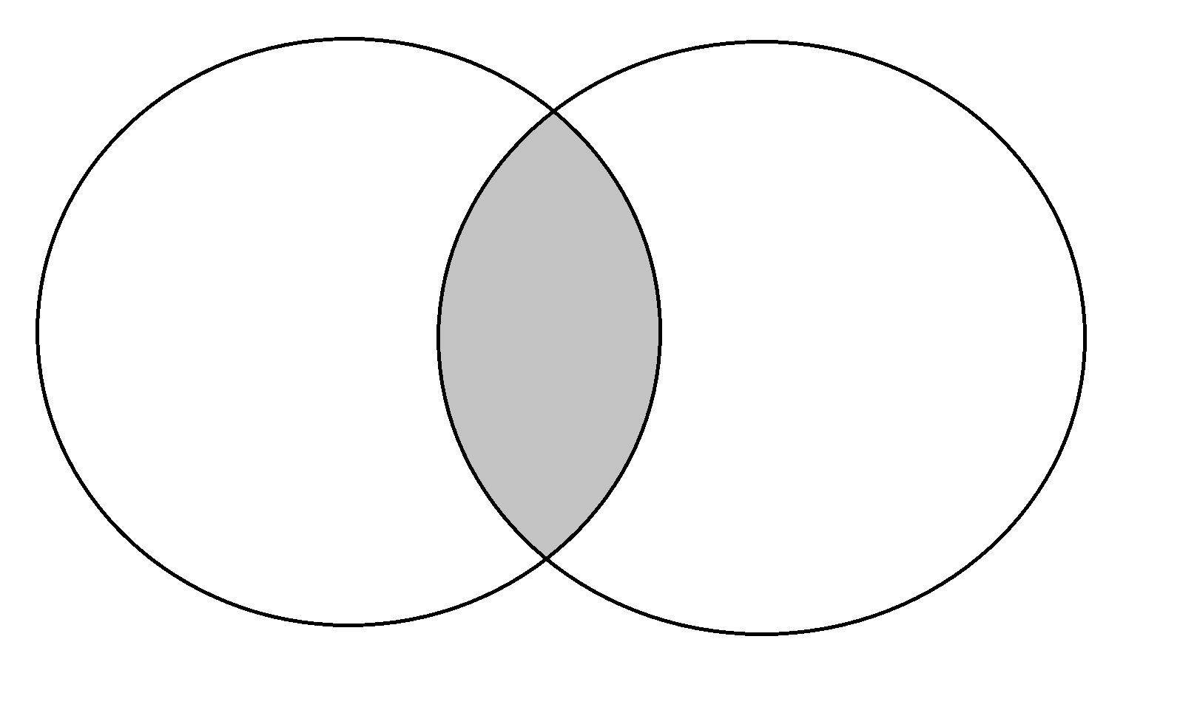
A ∩ B
diabetes ∩ cognitive behavioral therapy
A
B
N = 69

Slide 77
AND
diabetes AND cognitive behavioral therapy
A
B
N = 69

Slide 78
2do operador booleano
Unión u OR
No sabemos si el investigador dice diabetes o dm2

Slide 79
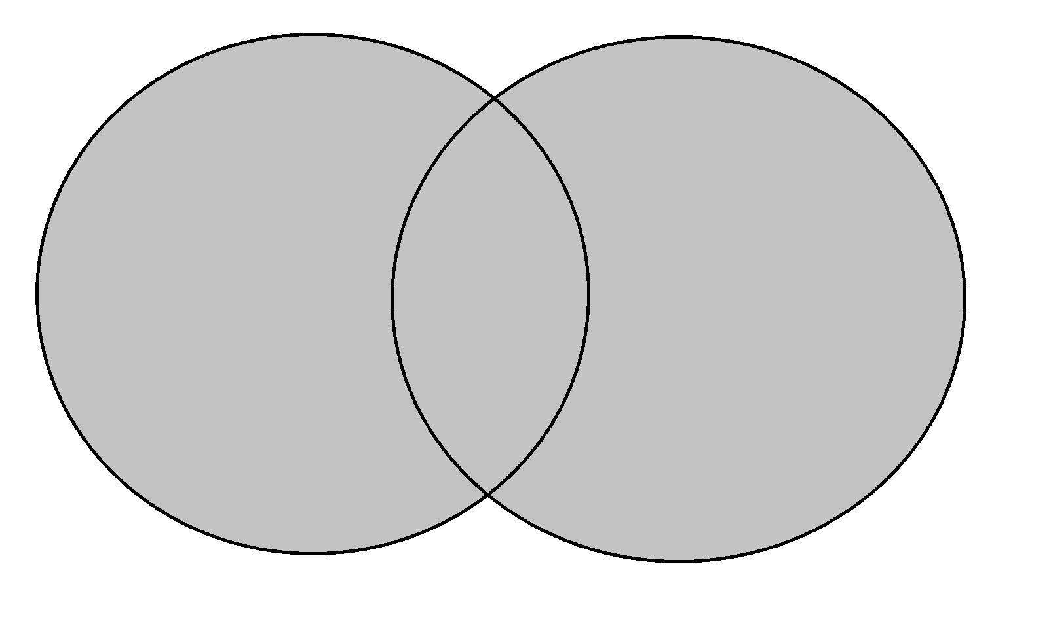
C ∪ B
psychological therapies ∪ cognitive behavioral therapy
C
B
N = 7859

Slide 80
OR
psychological therapies OR cognitive behavioral therapy
C
B
N = 7859

Slide 81
psychological therapies OR cognitive
behavioral therapy
cognitive behavioral therapy
psychological therapies

Slide 82
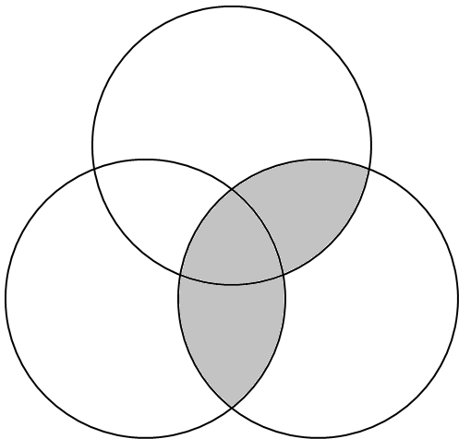
(psychological therapies OR cognitive
behavioral therapy) AND diabetes
cognitive
behavioral therapy
psychological therapies
diabetes

Slide 83
3er operador booleano
Exclusión o NOT

Slide 84
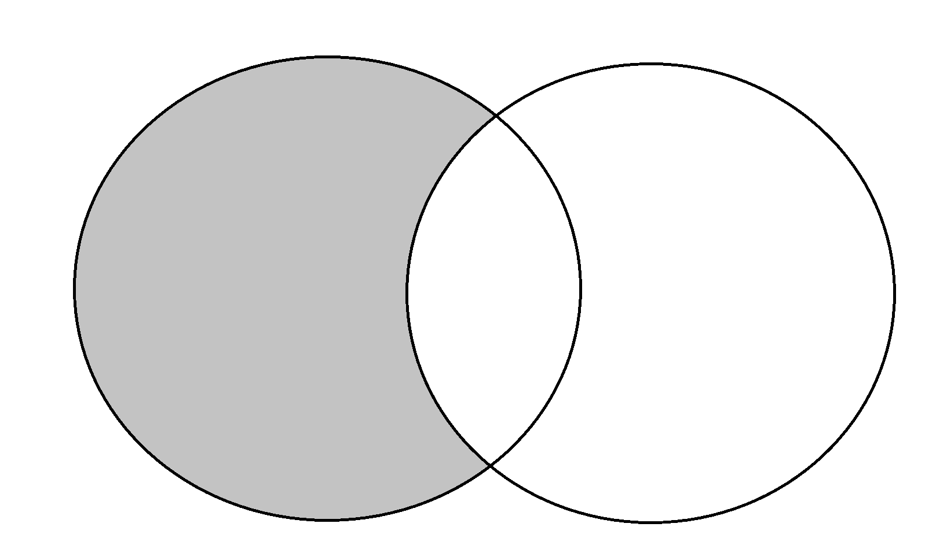
(A ∪ B) - B
diabetes NOT diagnostic
A
B
N = 432281

Slide 85
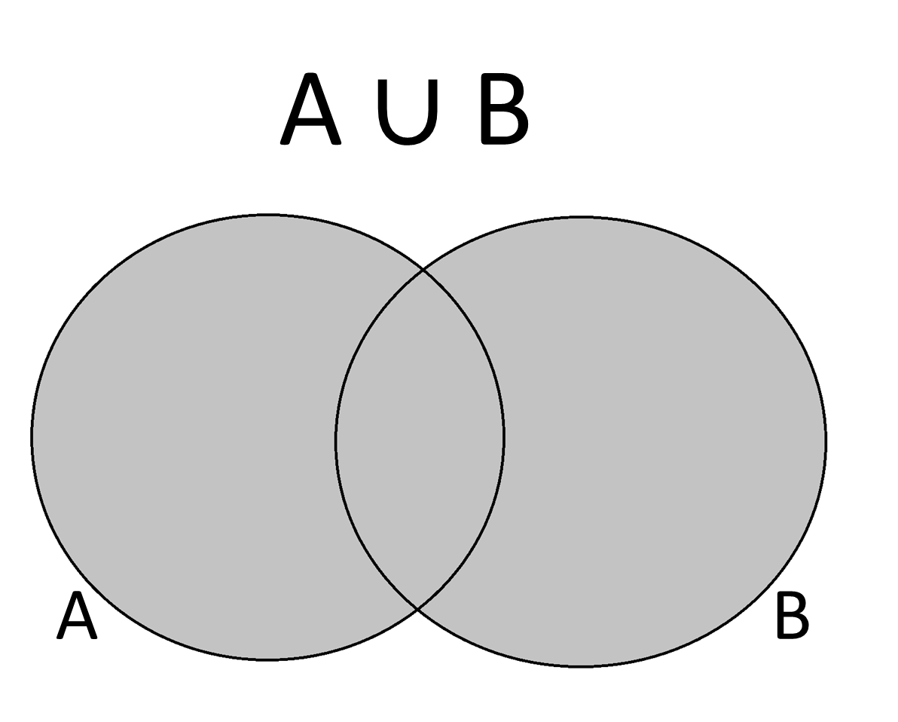
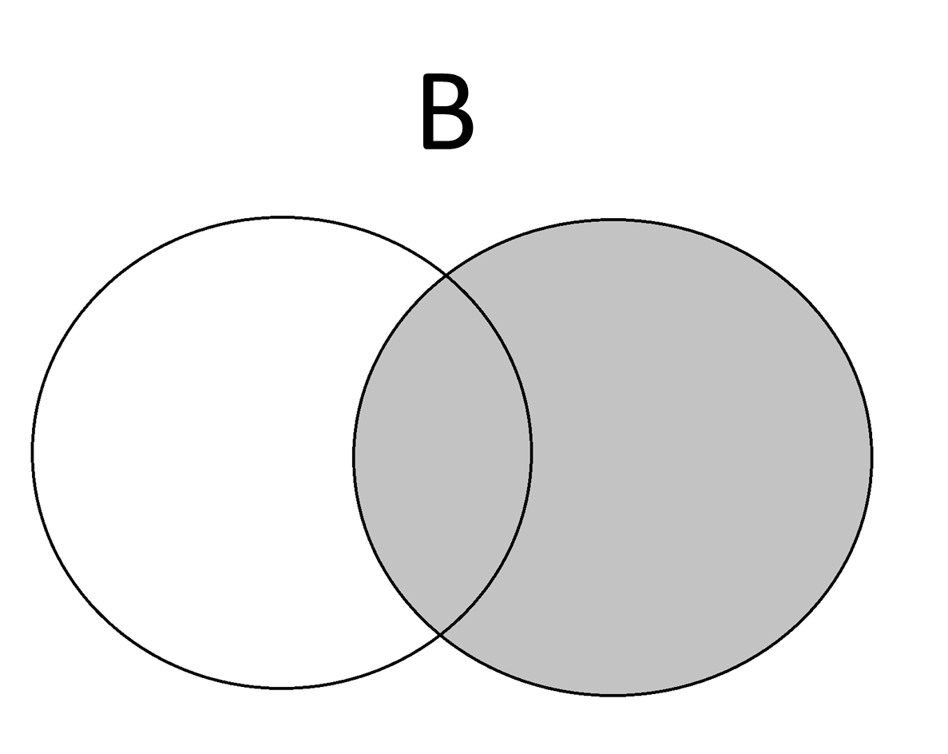
(A ∪ B) - B
-

Slide 86
NOT
diabetes NOT diagnostic
A
B
N = 432281

Slide 87


Slide 88





Slide 89


Slide 91


infoxicación

Slide 92


Slide 93



Slide 94

Notes:
BACKGROUND:
Studies indicate that a fraction of nursing professionals believe in a "lunar effect"-a purported correlation between the phases of the Earth's moon and human affairs, such as birth rates, blood loss, or fertility.
PURPOSE:
This article addresses some of the methodological errors and cognitive biases that can explain the human tendency of perceiving a lunar effect where there is none.
APPROACH:
This article reviews basic standards of evidence and, using an example from the published literature, illustrates how disregarding these standards can lead to erroneous conclusions.
FINDINGS:
Román, Soriano, Fuentes, Gálvez, and Fernández (2004) suggested that the number of hospital admissions related to gastrointestinal bleeding was somehow influenced by the phases of the Earth's moon. Specifically, the authors claimed that the rate of hospital admissions to their bleeding unit is higher during the full moon than at other times. Their report contains a number of methodological and statistical flaws that invalidate their conclusions. Reanalysis of their data with proper procedures shows no evidence that the full moon influences the rate of hospital admissions, a result that is consistent with numerous peer-reviewed studies and meta-analyses. A review of the literature shows that birth rates are also uncorrelated to lunar phases.
CONCLUSIONS:
Data collection and analysis shortcomings, as well as powerful cognitive biases, can lead to erroneous conclusions about the purported lunar effect on human affairs. Adherence to basic standards of evidence can help assess the validity of questionable beliefs.

Slide 95

Notes:
BACKGROUND:
Studies indicate that a fraction of nursing professionals believe in a "lunar effect"-a purported correlation between the phases of the Earth's moon and human affairs, such as birth rates, blood loss, or fertility.
PURPOSE:
This article addresses some of the methodological errors and cognitive biases that can explain the human tendency of perceiving a lunar effect where there is none.
APPROACH:
This article reviews basic standards of evidence and, using an example from the published literature, illustrates how disregarding these standards can lead to erroneous conclusions.
FINDINGS:
Román, Soriano, Fuentes, Gálvez, and Fernández (2004) suggested that the number of hospital admissions related to gastrointestinal bleeding was somehow influenced by the phases of the Earth's moon. Specifically, the authors claimed that the rate of hospital admissions to their bleeding unit is higher during the full moon than at other times. Their report contains a number of methodological and statistical flaws that invalidate their conclusions. Reanalysis of their data with proper procedures shows no evidence that the full moon influences the rate of hospital admissions, a result that is consistent with numerous peer-reviewed studies and meta-analyses. A review of the literature shows that birth rates are also uncorrelated to lunar phases.
CONCLUSIONS:
Data collection and analysis shortcomings, as well as powerful cognitive biases, can lead to erroneous conclusions about the purported lunar effect on human affairs. Adherence to basic standards of evidence can help assess the validity of questionable beliefs.

Slide 96
Sesgos cognitivos y deficiencias en análisis pueden llevarnos a concluir efecto de luna en asuntos humanos
(PD: ni trastornos psiquiátricos, ni tasa de nacimientos)
Margot, J. L. (2015). No evidence of purported lunar effect on hospital admission rates or birth rates. Nursing research, 64(3), 168.
Notes:
BACKGROUND:
Studies indicate that a fraction of nursing professionals believe in a "lunar effect"-a purported correlation between the phases of the Earth's moon and human affairs, such as birth rates, blood loss, or fertility.
PURPOSE:
This article addresses some of the methodological errors and cognitive biases that can explain the human tendency of perceiving a lunar effect where there is none.
APPROACH:
This article reviews basic standards of evidence and, using an example from the published literature, illustrates how disregarding these standards can lead to erroneous conclusions.
FINDINGS:
Román, Soriano, Fuentes, Gálvez, and Fernández (2004) suggested that the number of hospital admissions related to gastrointestinal bleeding was somehow influenced by the phases of the Earth's moon. Specifically, the authors claimed that the rate of hospital admissions to their bleeding unit is higher during the full moon than at other times. Their report contains a number of methodological and statistical flaws that invalidate their conclusions. Reanalysis of their data with proper procedures shows no evidence that the full moon influences the rate of hospital admissions, a result that is consistent with numerous peer-reviewed studies and meta-analyses. A review of the literature shows that birth rates are also uncorrelated to lunar phases.
CONCLUSIONS:
Data collection and analysis shortcomings, as well as powerful cognitive biases, can lead to erroneous conclusions about the purported lunar effect on human affairs. Adherence to basic standards of evidence can help assess the validity of questionable beliefs.

Slide 97
((“lunar effect” OR “moon effect”) OR “lunar effects”) AND “hospital admission”
“lunar effect” OR “moon effect” OR “lunar effects”
N = 37
“hospital admission”
N = 18480
N = 1

Slide 98
Herramientas de búsqueda
1. Operadores booleanos
2. Uso de “”
3. MeSH
4. Filtros
5. Descriptores

Slide 99


con “comillas”
hospital admission
N = 18481

Slide 100


sin “comillas”
0
hospital
admission
hospital AND admission
N = 107394

Slide 101

con AND
0
hospital
admission
hospital AND admission
N = 107394

Slide 102
Herramientas de búsqueda
1. Operadores booleanos
2. Uso de “”
3. MeSH
4. Filtros
5. Descriptores

Slide 103
¿Cómo busco, diabetes, diabetes mellitus, o DM2?

Slide 104


Slide 105

MeSH = Medical Subject Heading

Slide 106


Slide 107


Slide 108
Herramientas de búsqueda
1. Operadores booleanos
2. Uso de “”
3. MeSH
4. Filtros
5. Descriptores

Slide 109



Slide 110


Slide 111
Herramientas de búsqueda
1. Operadores booleanos
2. Uso de “”
3. MeSH
4. Filtros
5. Descriptores

Slide 112

Pacientes postoperatorios
P
I C
Chicle + usual Vs.
usual
O
Recuperación función gastrointestinal

Slide 113


Slide 114


Slide 115


Slide 116


Slide 117


Slide 118


Slide 119


Slide 120


Slide 122
Búsqueda de información
“NUEVA HABILIDAD CLÍNICA”
¡Gracias!

